Slide 1
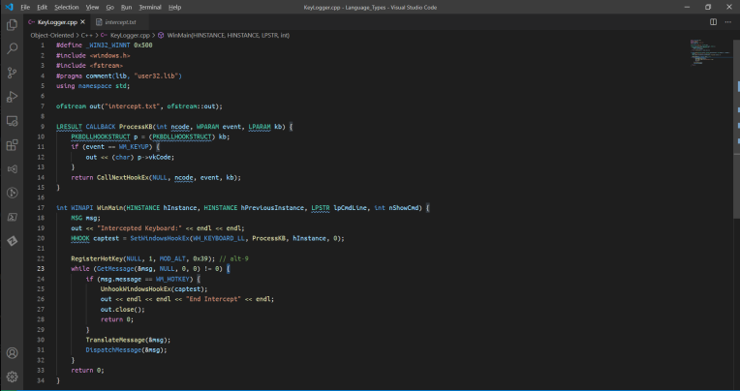
Coding a Keylogger
CyberSecurity Club

Slide 2


My Background:
Medical vs Bank Cybersecurity

Slide 3
Keylogger Attack
Keyloggers are easy to code
minimum of about 20 - 30 lines
easy to execute from a flash drive
Scenarios
Hospital with a sick friend
Your coworkers desktop
Your libraries computers / School Computers
There are real keyloggers, these are more for demonstration.

Slide 4
Languages Used
Every language was chosen for the following reasons:
Compiled (except Python) so no dependencies on interpreter
Design can be the same across languages. have the design before coding.
C / C++ - provide the master template
Go / swift - great for web interactions to get data out.
Python - special request.
C
C++
Obj-C
Swift
Python
Go

Slide 5
Why not other languages?
Examples exist
Java -> https://github.com/vakho10/java-keylogger
Uses -> https://github.com/kwhat/jnativehook
Relies on -> https://github.com/kwhat/libuiohook
This is a written in the language.... C!
Rust (for Windows) -> https://github.com/5ynatra/keylogger.rs
Rust (for Linux) -> https://github.com/gsingh93/keylogger
Points:
Everything leads back to the same input events
C and C++ - only "cross platform" languages
can use all OS effectively
Python with pynput
Great job of being cross platform
Requires python and pynput be installed on target.

Slide 6
Design
Because OS's and language variations are different, I'm going to do a high-level design:
Get the keyboard / input event to listen to
setup a function to process input events
write each event to a file detailing as much information in as few characters as possible
quit on a certain key-press or by killing the Keylogger.
On Windows and MacOS we use an Event-Driven Programming Model.
On Linux and in Go we use Procedural Programming
In Swift we also use Object Oriented Programming
Python uses pynput which abstracts Event-Driven code behind a class. (using specific contexts for various OS including using Xorg for Linux)

Slide 7
OS Specificity
Specific kernel Specification
Virtual Key Codes OS specific
Virtual Keycode '1':
on MacOS -> "s"
on Linux -> "ESC"
on Windows -> "Left Mouse Button Click"
MacOS and Windows - Events to hook into
Linux - read from keyboard or use "X"
Windows VkCodes -> https://docs.microsoft.com/en-us/windows/win32/inputdev/virtual-key-codes
Linux VkCodes -> https://github.com/torvalds/linux/blob/master/include/uapi/linux/input-event-codes.h
MacOS VkCodes -> https://github.com/phracker/MacOSX-SDKs/blob/master/MacOSX10.6.sdk/System/Library/Frameworks/Carbon.framework/Versions/A/Frameworks/HIToolbox.framework/Versions/A/Headers/Events.h (NOT OFFICIAL but can be found on your MAC)

Slide 8
Specialty keywords (Windows)
LRESULT
CALLBACK
WPARAM
LPARAM
PKBDLLHOOKSTRUCT
WINAPI
WinMain
HINSTANCE
LPSTR
MSG
HHOOK
Notes:
Windows uses a style called “Hungarian notation”
LRESULT -> Long (result) Pointer
CALLBACK -> A Windows Function Definition Type
WPARAM -> A 'Word' Parameter pointer (Unsigned int)
LPARAM -> A 'Long" Parameter Pointer (long )
PKBDLLHOOKSTRUCT -> Pointer to a Key Board DLL Hook structure (a keyboard input event)
WINAPI -> (same as callback) A Windows Function Definition Type
WinMain -> the windows specific entry point to a C program
HINSTANCE -> Handle to an instance (Handles are the way that Windows tracks running processes)
LPSTR -> Long Pointer to a String (an array of char*)
MSG -> a Message in the current threads Message queue (see MSG)
HHOOK -> Handle to the Hook

Slide 9
Specialty keywords (MacOS)
CGEventRef
CGEventMask
CFMachPortRef
CGEventTapCreate
CFMachPortCreateRunLoopSource
CFRunLoopAddSource
CGEventTapEnable
CFRunLoopRun
CG -> Core Graphics
CF -> Core Foundation
kCG -> (k)onstant Core Graphics
kCF -> (k)onstant Core Foundation
Notes:
CGEventRef -> Core Graphics Event Reference (Pointer)
CGEventMask -> Core Graphics Event Mask (a mask of which events to capture)
CFMachPortRef -> Core Foundation Machine Port Reference (A structure pointing into an event tap)
CGEventTapCreate -> creates an event tap ( a "tap" into events that are dispatched)
CFMachPortCreateRunLoopSource -> creates a run loop from a machine port
CFRunLoopAddSource -> adds a run loop into the currrent run loop
CGEventTapEnable -> enables an event tap, (or disables it)
CFRunLoopRun -> Core Foundation Run default Loop indefinately
CG -> Core Graphics
CF -> Core Foundation
kCG, kCF -> (k)onstant Core Graphics defs or (k)onstant Core Foundation defs.

Slide 10


Slide 11


Slide 12



This Photo by Unknown author is licensed under CC BY.

Slide 13
Resources
https://docs.microsoft.com/en-us/windows/win32/api/winuser/
https://github.com/vakho10/java-keylogger
https://github.com/5ynatra/keylogger.rs
https://github.com/gsingh93/keylogger
https://docs.microsoft.com/en-us/windows/win32/stg/coding-style-conventions
https://docs.microsoft.com/en-us/windows/win32/inputdev/virtual-key-codes
https://github.com/torvalds/linux/blob/master/include/uapi/linux/input-event-codes.h
https://github.com/phracker/MacOSX-SDKs/blob/master/MacOSX10.6.sdk/System/Library/Frameworks/Carbon.framework/Versions/A/Frameworks/HIToolbox.framework/Versions/A/Headers/Events.h
https://github.com/RappelBerryPi/KeyLogger

